Slide 1
Should a milk tea shop add one temporary staff member during peak hours?
--A combined Monte Carlo and queuing risk analysis
Group member
Chen Zeming
Deng Songhao
LIU Jiaming
Ma Ang
Wu Xin
Zhang Hanyuan
Zhang Shuoyan
2330036010
2330036015
2330036089
2330036106
2330036159
2330036186
2330036190
Group A

Slide 2
Contents
1. Introduction
2. Pre-modeling Stage
3. Order Generation
4. Queuing Model
5. Risk and Sensitivity Analysis
6. Result Analysis
7. Final Conclusions & Recommendations
8. Model Limitations

Slide 3
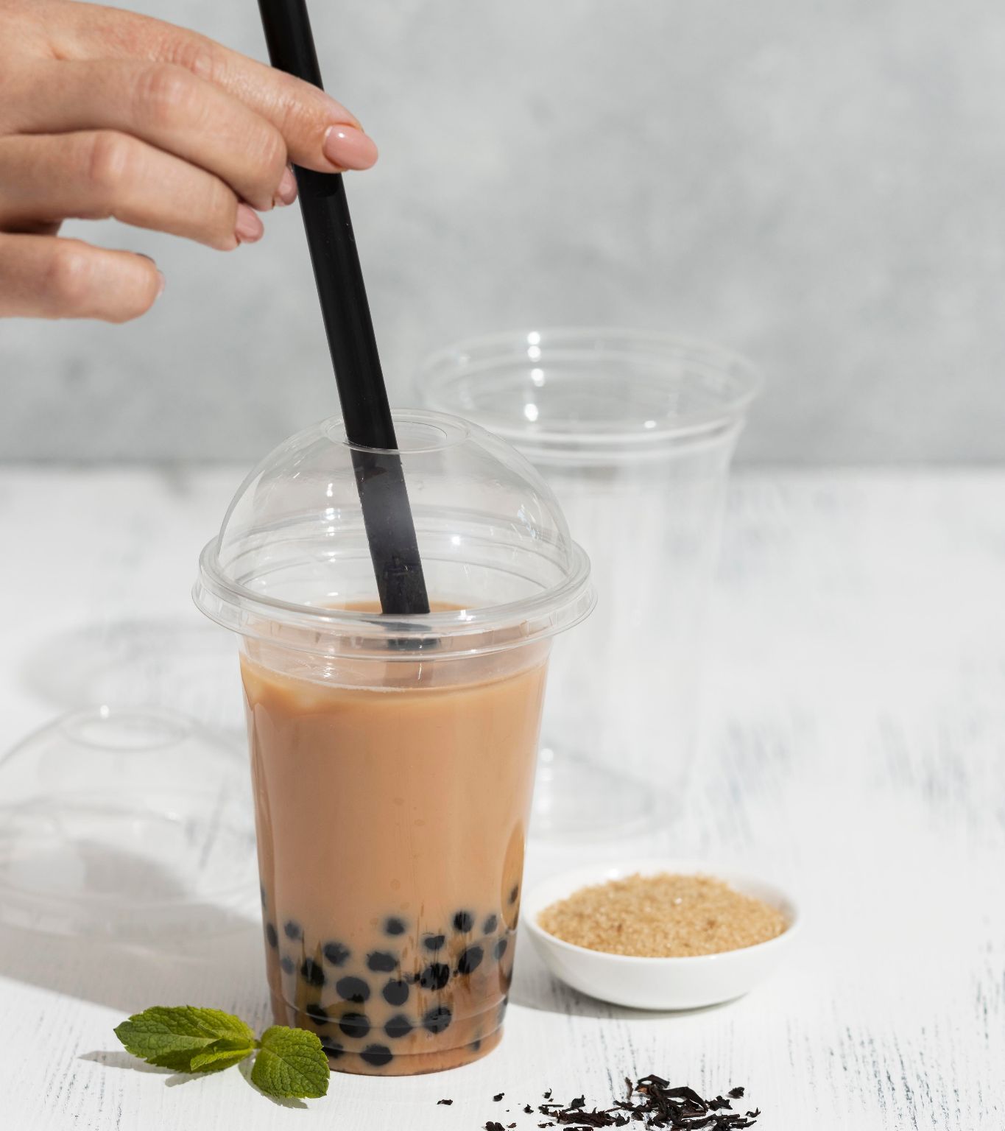

01
Our history
01
Introduction
Problem Definition & Scenario Statement
You can enter a subtitle here if you need it

Slide 4

Scenario Background:Guozi’s Tea
• May Day holiday in Tianjin
I visited Guozi’s Tea, a bubble tea shop owned by Guo Laoshi, a former local comedy influencer.
• A daily promotion
The shop was running a “second cup half-price” campaign to attract more customers.
• A real operating concern
During our conversation, he mentioned that the shop was becoming overloaded during the 3–5 p.m. peak period.
“A simple promotion became a capacity decision problem.”
Notes:
Hello everyone. Let me start by sharing a story. This past May Day holiday in Tianjin, I had the chance to visit a very special bubble tea shop called 'Guozi’s Tea'. It's owned by Guo Laoshi, a well-known local comedian. During my visit, the shop was running a popular 'second cup half-price' promotion. However, during our chat, Guo Laoshi shared a real concern: the shop was getting overwhelmed, especially during the afternoon peak hours from 3 to 5 PM. This simple promotion had unexpectedly turned into a complex operational challenge. This real-life observation is what inspired our simulation project.

Slide 5
From Business Problem to Scenario Design
A. Baseline
B. Promotion Only
No promotion + 2 staff
Normal operation baseline, representing the status quo without any marketing activities.
Promotion + 2 staff
Simulates the impact of higher customer demand while keeping the current labor capacity unchanged.
C. Add Capacity
D. Improve Process
Promotion + 1 part-time (3 peak hours)
Increases labor cost to test if extra service capacity during peak times improves customer satisfaction.
Promotion + 2 staff + Optimization
Measures the effect of workflow changes (menu standardization, batching) on handling higher demand.
These scenarios allow us to systematically compare the impact of promotion, staffing decisions, and process improvements.
Notes:
To address Guo Laoshi's problem, we designed four distinct operating scenarios for simulation. The first is our 'Baseline' scenario, representing normal operations without any promotion. The second is 'Promotion only', where we apply the promotion but keep the same staff level, which is the current situation. The third scenario, 'Add capacity', tests the effect of hiring an extra part-time worker during peak hours. Finally, the fourth scenario, 'Improve process', explores whether optimizing internal workflows can handle the increased demand without additional staff. These four scenarios will allow us to systematically compare the impact of promotion, staffing, and process improvements.

Slide 6
Project Objective & Simulation Method
Core Question: When promotion brings higher demand, should Guozi’s Tea keep 2 staff, add a part-timer, or optimize the service process?
Simulation Methods
Evaluation Metrics
• Monte Carlo Simulation: Models uncertainty in customer arrivals, order size, drink types, preparation times, and customer patience.
• Discrete-Event Queueing Simulation: Models staff availability, waiting times, queue formation, and customer abandonment behavior.
We will compare scenarios based on these key performance indicators (KPIs):
1. Order and Transaction Volume
2. Financial Metrics
3. Customer Experience and Queuing Performance
4. Staff and Operational Efficiency
5. Risk
GOAL: Identify the most practical strategy that balances profit, service quality, and operational risk.
Notes:
So, our project's core question is: what is the best strategy for Guozi’s Tea when faced with increased demand from the promotion? Should they stay with two staff, add a part-timer, or improve their process? To answer this, we will use two powerful simulation methods: Monte Carlo simulation to model the inherent randomness of customer behavior, and Discrete-Event simulation to model the queuing and service process. We will evaluate each scenario based on five key metrics: Profit, Average Waiting Time, Customer Abandonment Rate, Staff Utilization, and Downside Risk. Our ultimate goal is to identify the most practical strategy that strikes the best balance between profit, service quality, and operational risk.

Slide 7
01
Our history
02
Pre-modeling Stage
Parameter setup and scenario design
You can enter a subtitle here if you need it

Slide 8
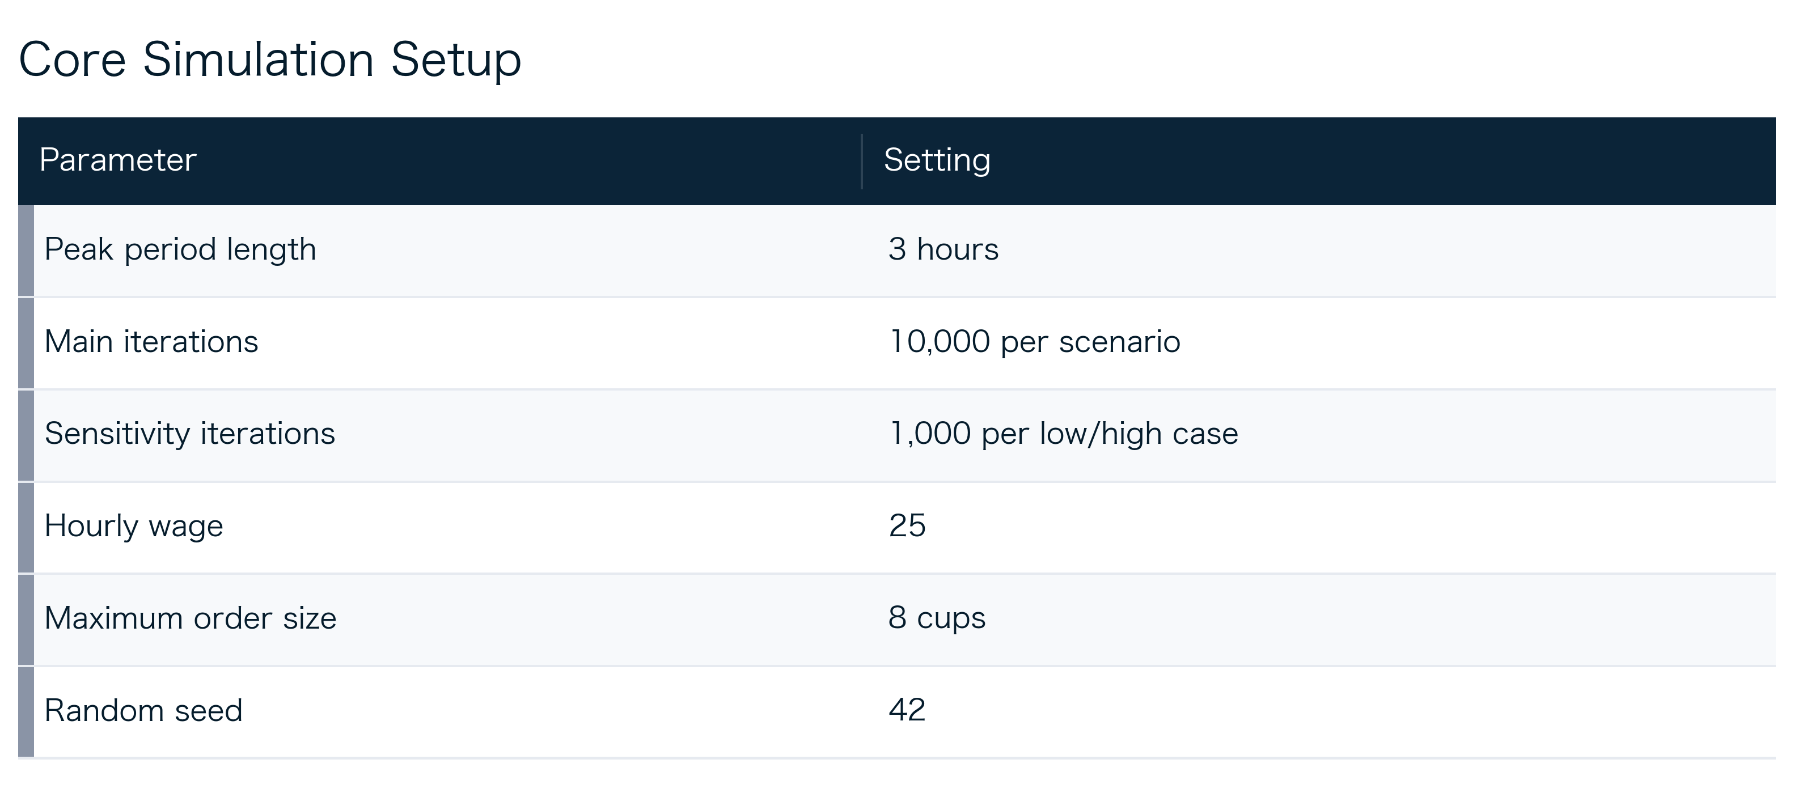
Tea and coffee menu
From Business Question to Model Inputs
The promotion problem is translated into simulation-ready operating assumptions.
 | Tea | Coffee | Latte/milk | Fruits
Caramel | 4,30€ | 4,50€ | 4,30€
Vanilla | 4,30€ | 4,50€ | 4,50€
Hazelnut | 4,30 € | 4,50€ | 4,50€
Jazmin | 4,30 € |  |  | 4,40€
Sea salt caramel | 4,30€ | 4,50€ | 4,50€
Spice chai | 4,40€ |  | 4,50€ | 4,50€
Cinnamon | 4,30€ | 4,50€ | 4,50€
Peak window
Simulation scale
Reproducibility
3-hour busy period
10,000 Monte Carlo runs per scenario; 1,000 runs per sensitivity case
Fixed wage, maximum order size and seed

Slide 9
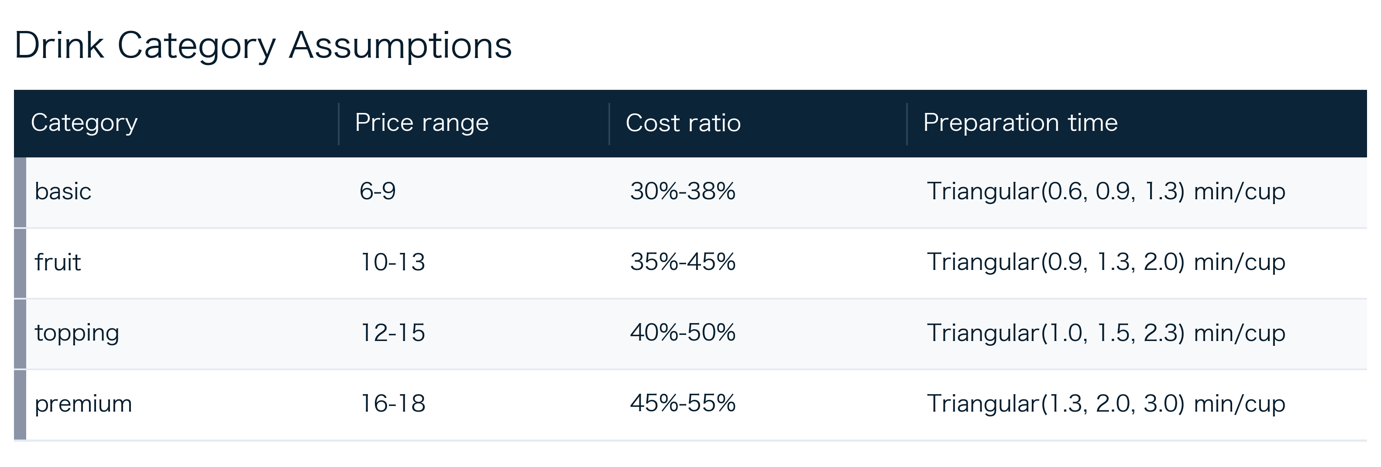
Tea and coffee menu
Product Inputs Use Four Drink Categories
Many SKUs are grouped into interpretable categories with price, cost, and prep-time logic.
 | Tea | Coffee | Latte/milk | Fruits
Caramel | 4,30€ | 4,50€ | 4,30€
Vanilla | 4,30€ | 4,50€ | 4,50€
Hazelnut | 4,30 € | 4,50€ | 4,50€
Jazmin | 4,30 € |  |  | 4,40€
Sea salt caramel | 4,30€ | 4,50€ | 4,50€
Spice chai | 4,40€ |  | 4,50€ | 4,50€
Cinnamon | 4,30€ | 4,50€ | 4,50€
Four categories
Category economics
Prep time
Basic, fruit, topping, and premium
Each group carries price, cost and preparation time
Triangular distribution handles limited data

Slide 10
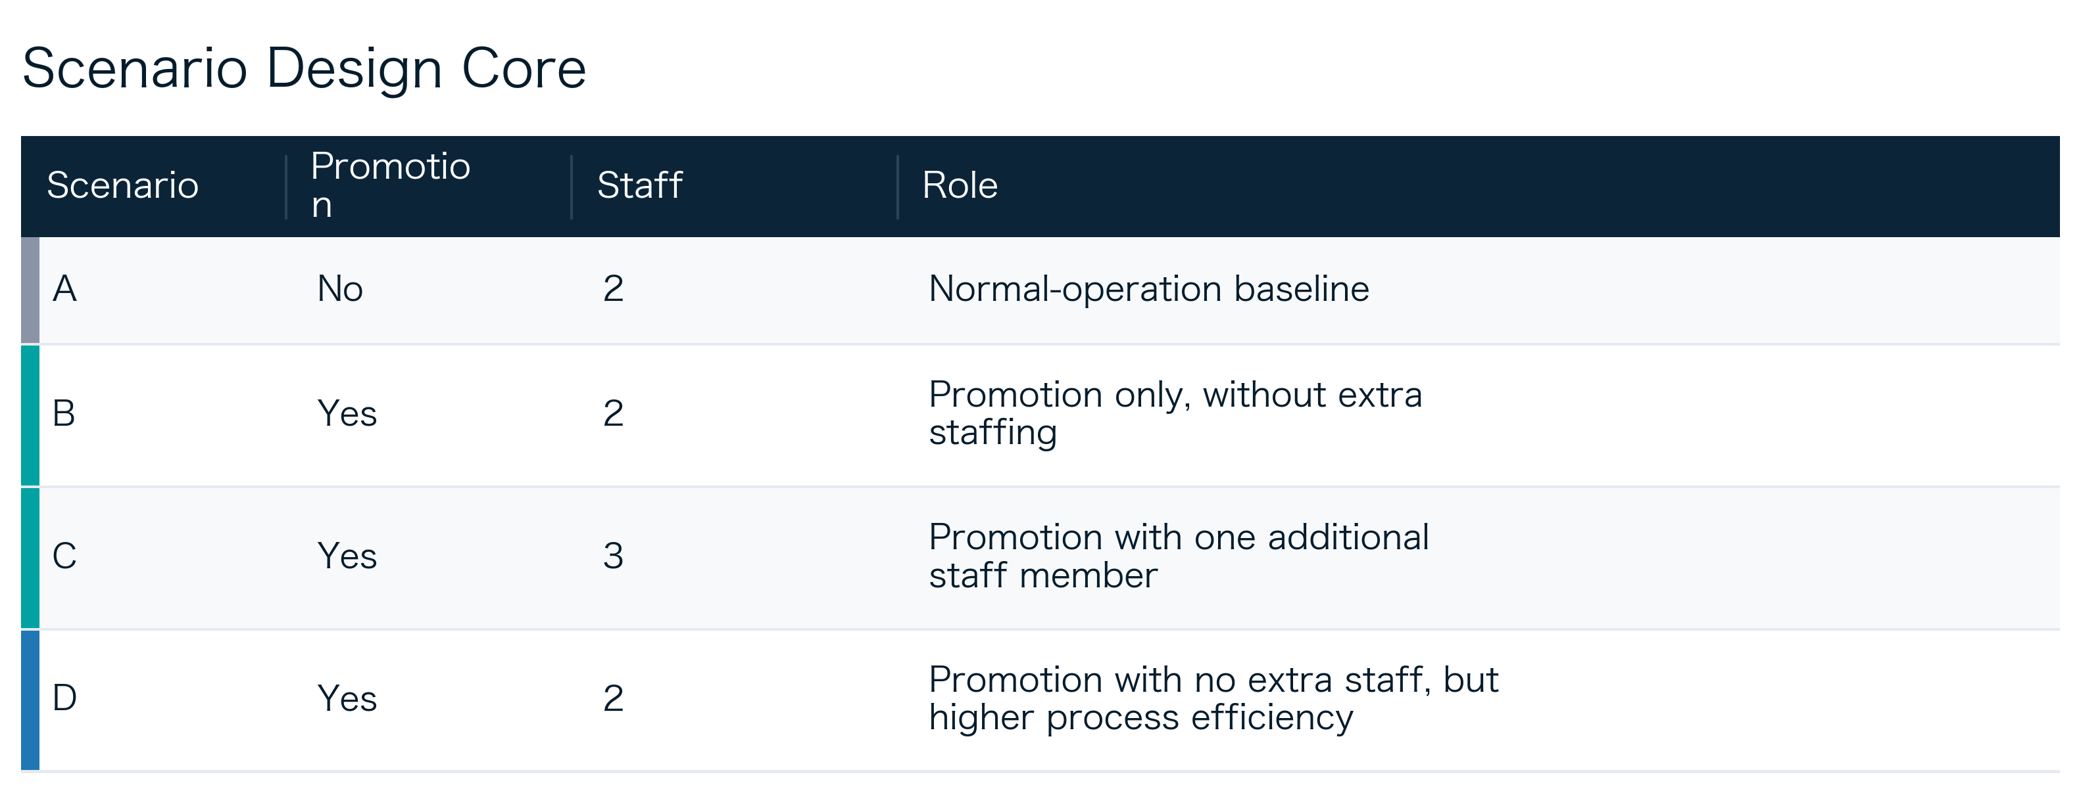
Tea and coffee menu
Four Scenarios Define the Experiment
The design isolates promotion effects, staffing changes, and process improvement.
 | Tea | Coffee | Latte/milk | Fruits
Caramel | 4,30€ | 4,50€ | 4,30€
Vanilla | 4,30€ | 4,50€ | 4,50€
Hazelnut | 4,30 € | 4,50€ | 4,50€
Jazmin | 4,30 € |  |  | 4,40€
Sea salt caramel | 4,30€ | 4,50€ | 4,50€
Spice chai | 4,40€ |  | 4,50€ | 4,50€
Cinnamon | 4,30€ | 4,50€ | 4,50€
A
B
C
D
Normal baseline, no promotion
Promotion only, same staff
Promotion with one additional staff
Promotion with process improvement

Slide 11
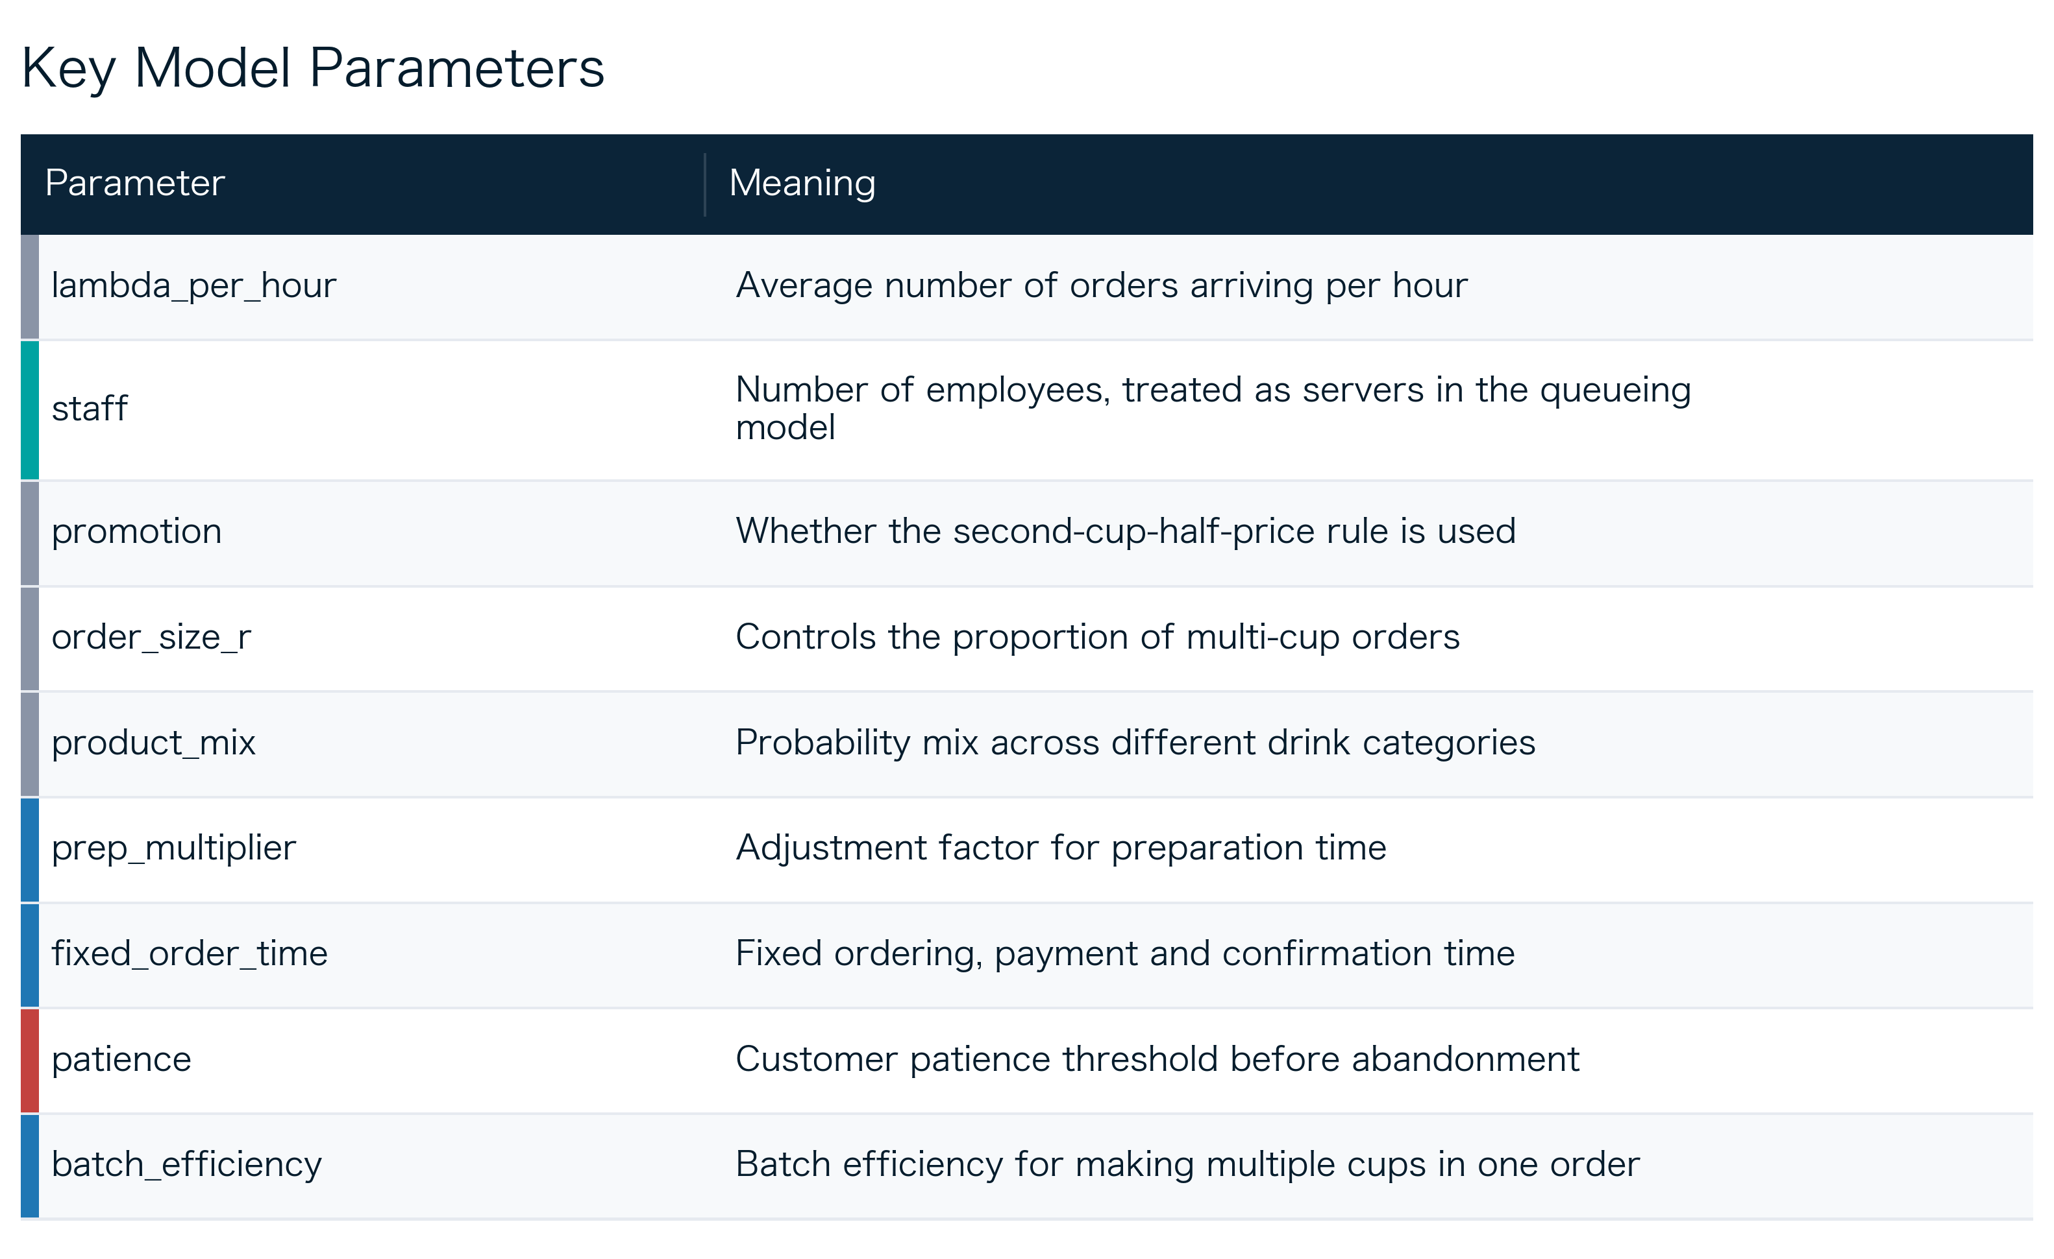
Tea and coffee menu
Key Parameters Link Operations to Simulation Logic
Inputs connect demand, service capacity, order structure, efficiency, and abandonment.
 | Tea | Coffee | Latte/milk | Fruits
Caramel | 4,30€ | 4,50€ | 4,30€
Vanilla | 4,30€ | 4,50€ | 4,50€
Hazelnut | 4,30 € | 4,50€ | 4,50€
Jazmin | 4,30 € |  |  | 4,40€
Sea salt caramel | 4,30€ | 4,50€ | 4,50€
Spice chai | 4,40€ |  | 4,50€ | 4,50€
Cinnamon | 4,30€ | 4,50€ | 4,50€
Demand and capacity
Order structure
Service risk
Arrival rate and staff determine queue pressure
Order size and product mix shape workload
Prep time, batching, and patience drive abandonment

Slide 12
03
Order Generation
Notes:
Let's begin with the first section: Order Arrival. This part of the model is crucial as it sets the foundation for the entire simulation by determining how many customers arrive and at what times during the peak hours. Accurately modeling customer flow is essential for understanding the shop's operational load.

Slide 13
1.Order Quantity
Average number of orders during peak hours :
Expected Arrivals = λ × Peak Hours
Poisson distribution
which is ideal for modeling the random arrival of events over a fixed interval.
N ∼ Poisson (Expected Arrivals)
This ensures that the simulation reflects the natural variability in customer traffic.
Random Arrival Patterns
based on statistical distribution
constant arrival rate
independent increments
orderliness
Notes:
To determine the order quantity, we first calculate the expected number of arrivals by multiplying the average arrival rate (λ) by the duration of peak hours. Since customer arrivals are random, we use a Poisson distribution to generate the actual number of orders. This distribution is perfect for this scenario as it models the probability of a given number of events occurring in a fixed period, which is exactly what we observe with customer arrivals.

Slide 14
2.The Arrival Time of the Order
Random Generation
Sorting & Example
Generate random arrival times for each order within the peak hour window (0 to 180 minutes). These times are then sorted chronologically to create a realistic queue for the queuing model to process.
Examples:
[0.5, 1.8, 3.2, 5.0, ..., 179.4]
This sequence ensures customers are served in the order they arrive.
Notes:
Once we know how many orders to expect, we assign each order a specific arrival time. We generate these times randomly within the peak hour duration, from 0 to 180 minutes. After generating all times, we sort them from earliest to latest. This sorted list represents the actual queue of customers, allowing our queuing model to process each order in the correct sequence, just like in a real shop.

Slide 15
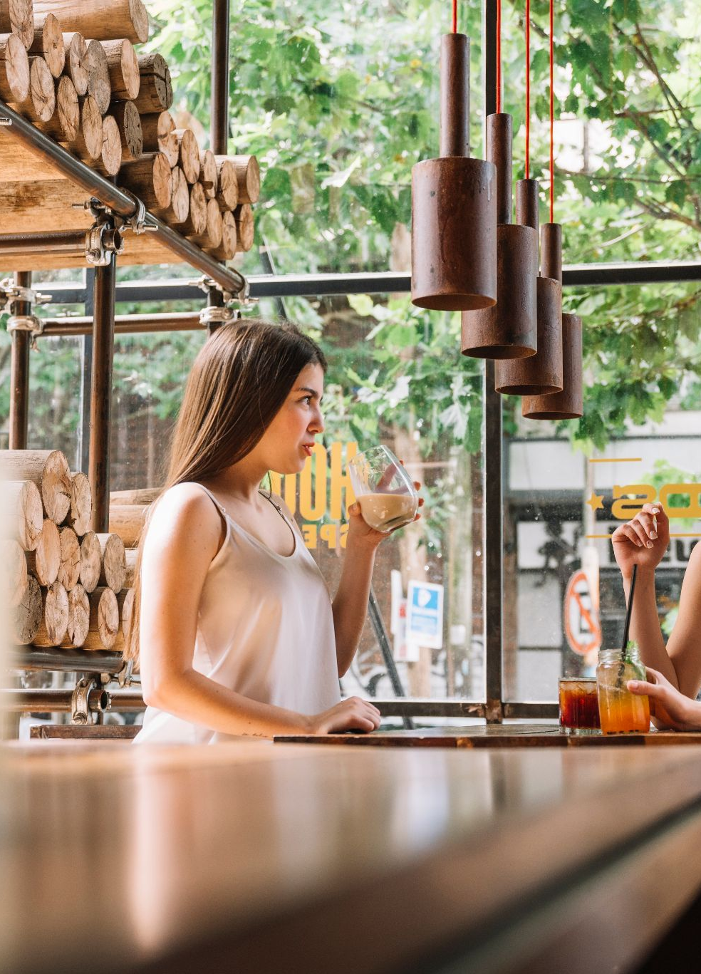
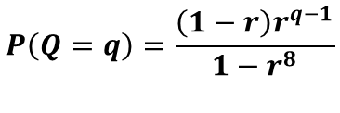
3.Number of Cups per Order
Truncated geometric distribution to model the number of cups per order, which allows a maximum of 8 cups.
Formula:
Key Characteristics:
Probability consistently decreases as, the quantity (q) increases.
Parameter 'r' (0 < r < 1) directly influences the likelihood of larger orders.
$$P\left(Q=q\right)=\frac{\left(1−r\right)r^{q−1}}{1−r^{8}}$$
Notes:
To determine how many cups are in each order, we use a truncated geometric distribution. This is because research shows that while customers can order up to 8 cups, the probability of ordering a large number is much lower than ordering a single cup. The formula you see here ensures that the probability of an order having 'q' cups decreases as 'q' increases, which accurately reflects real-world behavior. The parameter 'r' allows us to adjust how often larger orders occur.

Slide 16
4.Revenue Calculation Rule
EXAMPLE
1. Sort drink prices in descending order.
Order: [18, 15, 12, 8, 6]
Sorted: [18, 15, 12, 8, 6]
Pairs: (18, 15), (12, 8)
Single: (6)
2. Pair drinks sequentially.
3. The cheaper drink in each pair is half-price.
18 + (15 × 0.5) + 12 + (8 × 0.5) + 6
= 18 + 7.5 + 12 + 4 + 6
= 47.5
(Discounted: 15, 8)
4. Any unpaired drink is at full price.
Notes:
Calculating the revenue for each order requires careful handling of promotions. For the "half-price on the second cup" rule, we first sort the drink prices from highest to lowest. We then pair the first with the second, the third with the fourth, and so on. In each pair, the cheaper drink gets the half-price discount. If there's an odd number of drinks, the last one is full price. Let's look at an example: for an order of five drinks priced at 18, 15, 12, 8, and 6, after sorting and pairing, the 15 and 8 are discounted, resulting in a total revenue of 47.5.

Slide 17
5.Order Cost & Service Time
Order Cost
Service Time
Calculated by multiplying its simulated price by a random cost ratio, which represents the cost of raw materials.
Cost = Price × Cost Ratio
An 'Effective Batch Efficiency' factor to account for shared preparation steps, making the total time less than the sum of individual preparation times.
Service Time = Fixed Order Time + (Effective Batch Efficiency × Prep Time Sum)
Notes:
The cost of each order is straightforward: it's the price of the drink multiplied by a cost ratio, which simulates the cost of ingredients. For service time, we differentiate between single and multiple cup orders. A single cup has a fixed order time plus preparation time. For multiple cups, we use an 'Effective Batch Efficiency' factor. This factor recognizes that some steps, like boiling water or preparing syrup, can be done for multiple drinks at once, making the total service time more efficient than simply adding up the time for each individual cup.

Slide 18
Final Outputs of Order Generation
Return Value | Meaning | Usage
arrival_times | Order arrival time for each order | Process orders chronologically in the queuing model
order_sizes | Number of cups per order | Calculate the average order size
revenues | Revenue generated per order | Included in total revenue after successful service
variable_costs | Raw material cost per order | Included in total cost after successful service
service_times | Service duration per order | Determines how long staff members are occupied
Notes:
This table summarizes the final outputs of our order generation model. We have 'arrival_times' to sequence the orders, 'order_sizes' to know how many cups are in each, 'revenues' and 'variable_costs' for financial analysis, and 'service_times' to determine the workload on staff. Each of these outputs feeds directly into the queuing model to simulate the actual shop operations.

Slide 19
04
Queuing Model
A limited-duration M/G/c queuing system with customer churn, implemented through discrete event simulation.

Slide 20
Queuing Model
A limited-duration M/G/c queuing system with customer churn, implemented through discrete event simulation
M: Customer arrivals follow a Poisson process (Markovian), with an arrival rate of λ (people per unit time). G: The service time follows any general distribution (General), only requiring the existence of the mean E[S] and variance Var(S). c: c parallel service counters (C ≥ 1), customers queue in single groups and are served on a first-come, first-served basis (FCFS).
We process the orders one by one in the order of customer arrival.

Slide 21
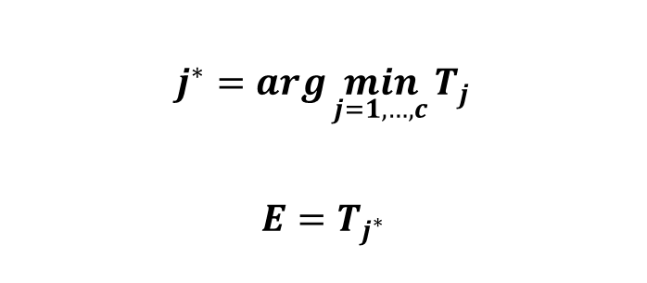
1. Queueing Logic

A: Time: 10th min
B: Time: 12th min
When a customer arrives, find an available employee or the one who finished work earlier to serve that customer.
$$j^{∗}=\arg{\min_{j=1,…,c}{T_{j}}}$$
$$E=T_{j^{∗}}$$

Slide 22
2. Customer Waiting Time
Waiting Time = max (0, Earliest Server Free Time − Arrival Time)
If the staff is available when the customer arrives,
earliest available time < arrival time
then the waiting time should be 0.
If the employee is not available,
earliest available time > arrival time
then the customer will have to wait:
waiting time = earliest available time – arrival time

Slide 23
3. Update Employee Status
Service start time:
$$ServiceStart=max⁡(Arrival Time, Earliest Available Time)$$
Service end time:
$$Service Finish=Service Start+Service Time$$
Then update the status of the employees:
$$Server Free Time=Service Finish$$
The meaning is that after this employee takes on this order, they have to finish it before they can take on the next one.

Slide 24
4. Total Profit
First, we determine whether the customer has left.
If the waiting time exceeds the customer's patience, the customer will leave and the profit will be 0.
If Waiting Time > Customer Patience, then customer abandons, then
Revenue=0; Variable Cost=0
Lost Potential Profit = Revenue – Variable Cost
If the customer does not leave (Waiting Time < Customer Patience), then the profit will be:
Profit = Revenue−Variable Cost − Labour Cost
Labour Cost = Staff × Hourly Wage × Peak Hours
For example, there are 2 employees, with an hourly wage of 25, and they work for 3 hours during peak hours: 2 × 25 × 3 = 150

Slide 25
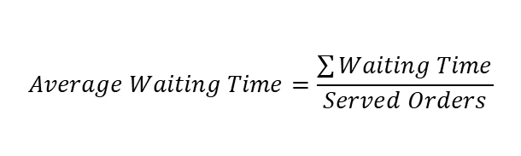


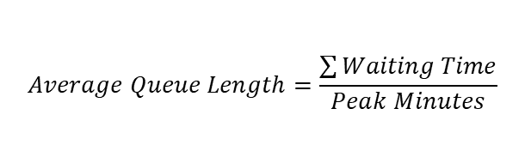

5. Queueing Indicators
$$Average Waiting Time=\frac{\sum{Waiting Time}}{Served Orders}$$
$$Workload Ratio=\frac{Total Service Time}{Staff×Peak Minutes}$$
$$Abandonment Rate=\frac{Lost Orders}{Total Arrivals}$$
$$Utilisation=\frac{Total Busy Time}{Staff×Peak Minutes}$$
$$Average Queue Length=\frac{\sum{Waiting Time}}{Peak Minutes}$$
NOTE:
(1) Utilization is calculated based on the actual duration of being busy during peak hours.
(2) Workload ratio measures the total service time for all successfully processed service orders, including those that extend beyond 180 minutes.

Slide 26
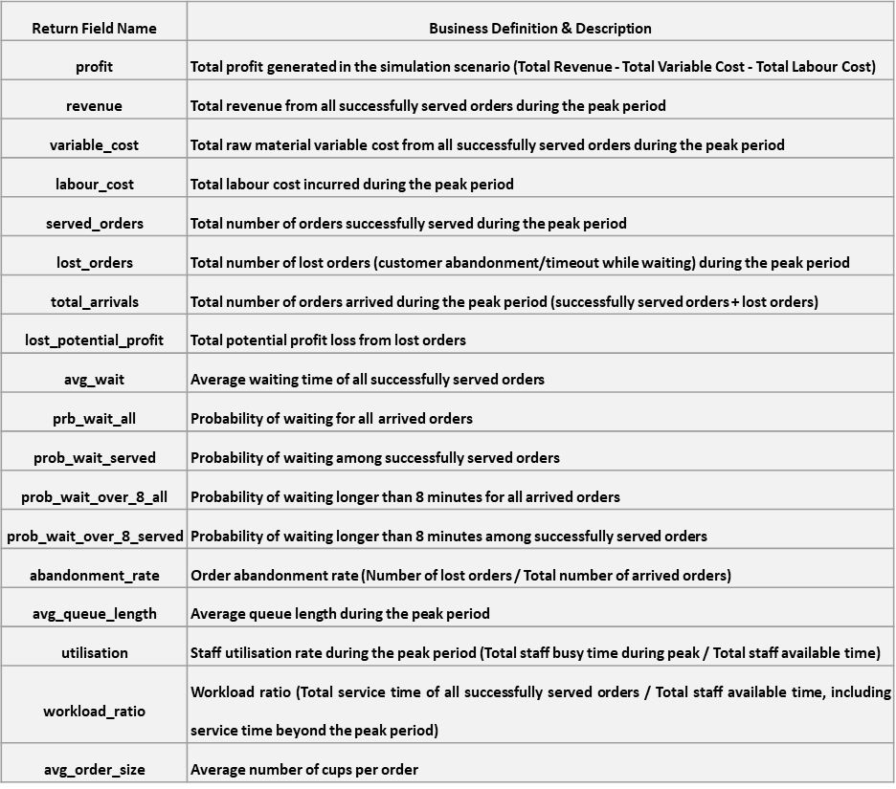
Output Return
Note: The formulas for some indicators are not provided, but the calculation logic is similar to that of other formulas.

Slide 27
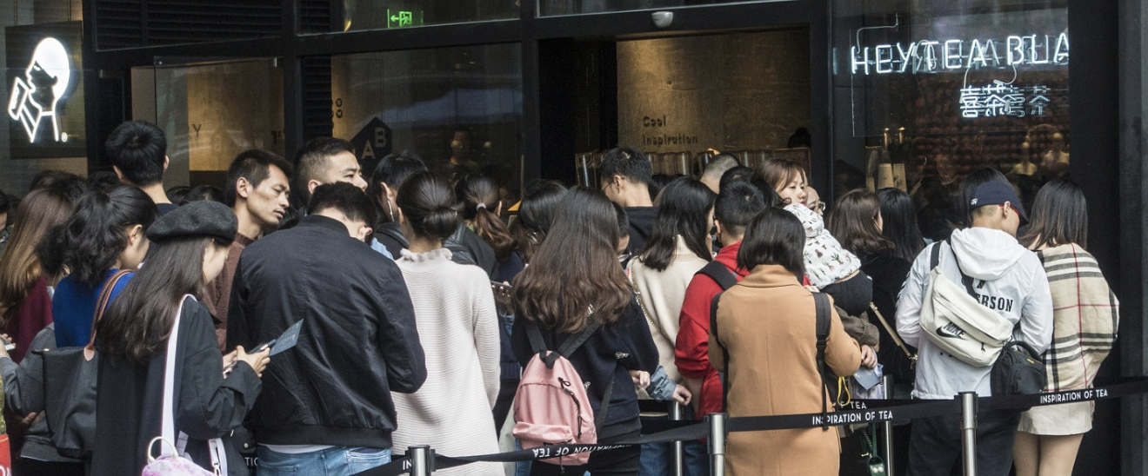
5. Risk and Sensitivity Analysis

Slide 28
Promotion & Queue Risk Analysis
Significance: Why Risk Analysis matters in this context?
Therefore, we need to find our what benefit and risk that these 4 strategies would bring us.
Promotion
Demand & Revenue
waiting & abandonment
Modeling Approach: How our project achieve it?
Component | Purpose | Key Inputs
Monte Carlo Simulation | Model randomness | Arrival rate, order size, drink mix, prep time, patience
Discrete-Event Queueing | Model service dynamics | Staff count, FCFS logic, abandonment threshold
Risk Analysis | Evaluate downside | * VaR95, CVaR95, profit distribution

Slide 29
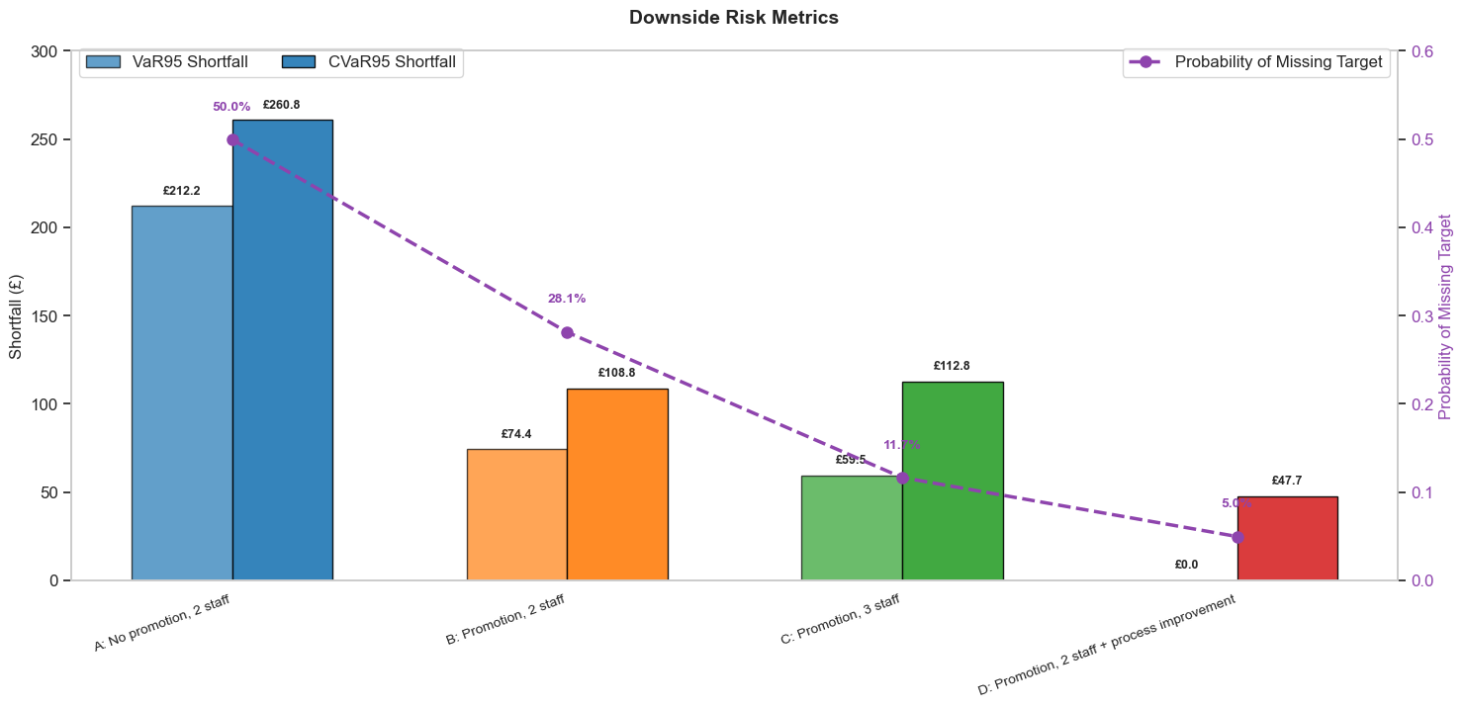
Result of Risk Analysis
Highest Risk Strategy
Lowest Risk Strategy
Notes:
Here are the main features of the chart summarized in English, suitable for your PowerPoint presentation:
Chart Overview: The graph compares downside risk across four operational scenarios using three key metrics: **VaR95 Shortfall**, **CVaR95 Shortfall** (bars), and the **Probability of Missing Target** (purple dashed line).
Highest Risk (Scenario A): The "No promo, 2 staff" scenario exhibits the highest risk profile. It has the highest probability of missing the target (**50.4%**) and the largest financial shortfalls (CVaR95 of **£267.9**).
Lowest Risk / Best Strategy (Scenario D): The "Promo, 2 staff + process" scenario offers the best risk mitigation. It has the lowest probability of missing the target (**5.1%**) and a negligible VaR95 shortfall (**£0.6**), making it the most stable option.
Impact of Promotion: Introducing a promotion (Scenarios B, C, and D) significantly reduces the probability of falling below the profit target compared to the baseline Scenario A (dropping from >50% to <15%).
Process Efficiency vs. Staffing: Scenario D (Process Improvement) demonstrates lower financial risk (shortfall) than Scenario C (Adding a 3rd staff member). This suggests that optimizing workflows is more effective for minimizing downside risk than simply increasing headcount.
VaR95 (Light Blue): This is our risk threshold. It tells us that in the worst 5% of days, our profit will drop by at least this amount.
CVaR95 (Dark Blue): This is the expected loss. It tells us the average loss in those worst 5% of days. Notice that CVaR is always higher than VaR because it accounts for the most extreme outliers.
Scenario D minimizes downside risk: Even in the worst 5% of cases, profit remains stable, whereas Scenario C exposes the business to high losses due to fixed labor costs.

Slide 30
Sensitivity Analysis
Approach: Using Scenario B as baseline, this project conducts one-at-a-time sensitivity analysis
Outcome is calculated by: ABS(MeanProfit_high – MeanProfit_low)
Rationale: Scenario B represents a high-risk scenario of running promotions without adding staff, which is sensitive to the change in operation.
Key Parameter
Parameter Tested | Low Setting | High Setting | Meaning
Arrival rate (λ) | 40/hr | 60/hr | Arrival rate range
Order-size parameter (r) | 0.42 | 0.62 | The probability of multi-cups in an order
Preparation time multiplier | 0.85 | 1.15 | Preparation time (fast/slow)
Customer patience | (4,6,10) min | (6,10,14) min | The tolerance of customer patience
Raw material cost multiplier | 0.90 | 1.10 | The cost of raw material
Notes:
In this approach, each parameter is varied individually between its low and high values while keeping all other parameters at their baseline levels, allowing us to isolate and measure the individual impact of each parameter on profit, waiting time, and customer abandonment rate.
Identify key risk drivers: Scenario B represents a high-risk scenario of "running promotions without adding staff," requiring identification of which parameter variations have the most significant impact on profitability.
Quantify the impact of uncertainty: Assess the extent to which profit and customer experience are affected when actual operational parameters deviate from their expected values.

Slide 31
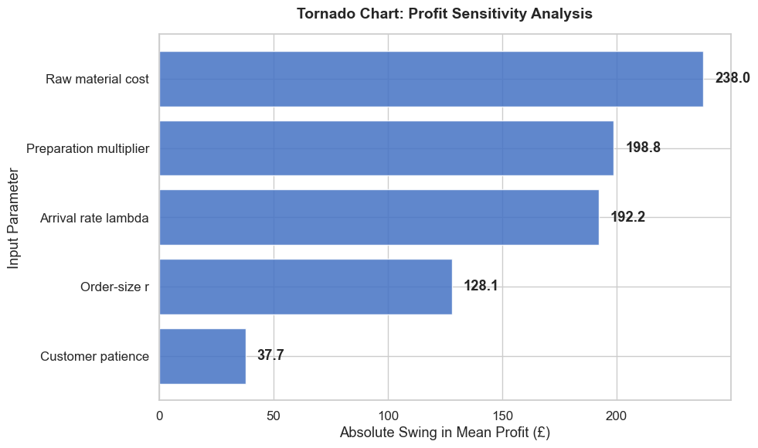
Result of Sensitivity Analysis
Notes:
The sensitivity analysis further reveals that arrival rate, raw material costs, and preparation speed are the three most critical risk factors affecting profitability, suggesting managers should focus monitoring efforts on demand forecasting, supply chain stability, and operational workflow rather than solely on customer patience or minor pricing tweaks.

Slide 32
06
Results Analysis

Slide 33
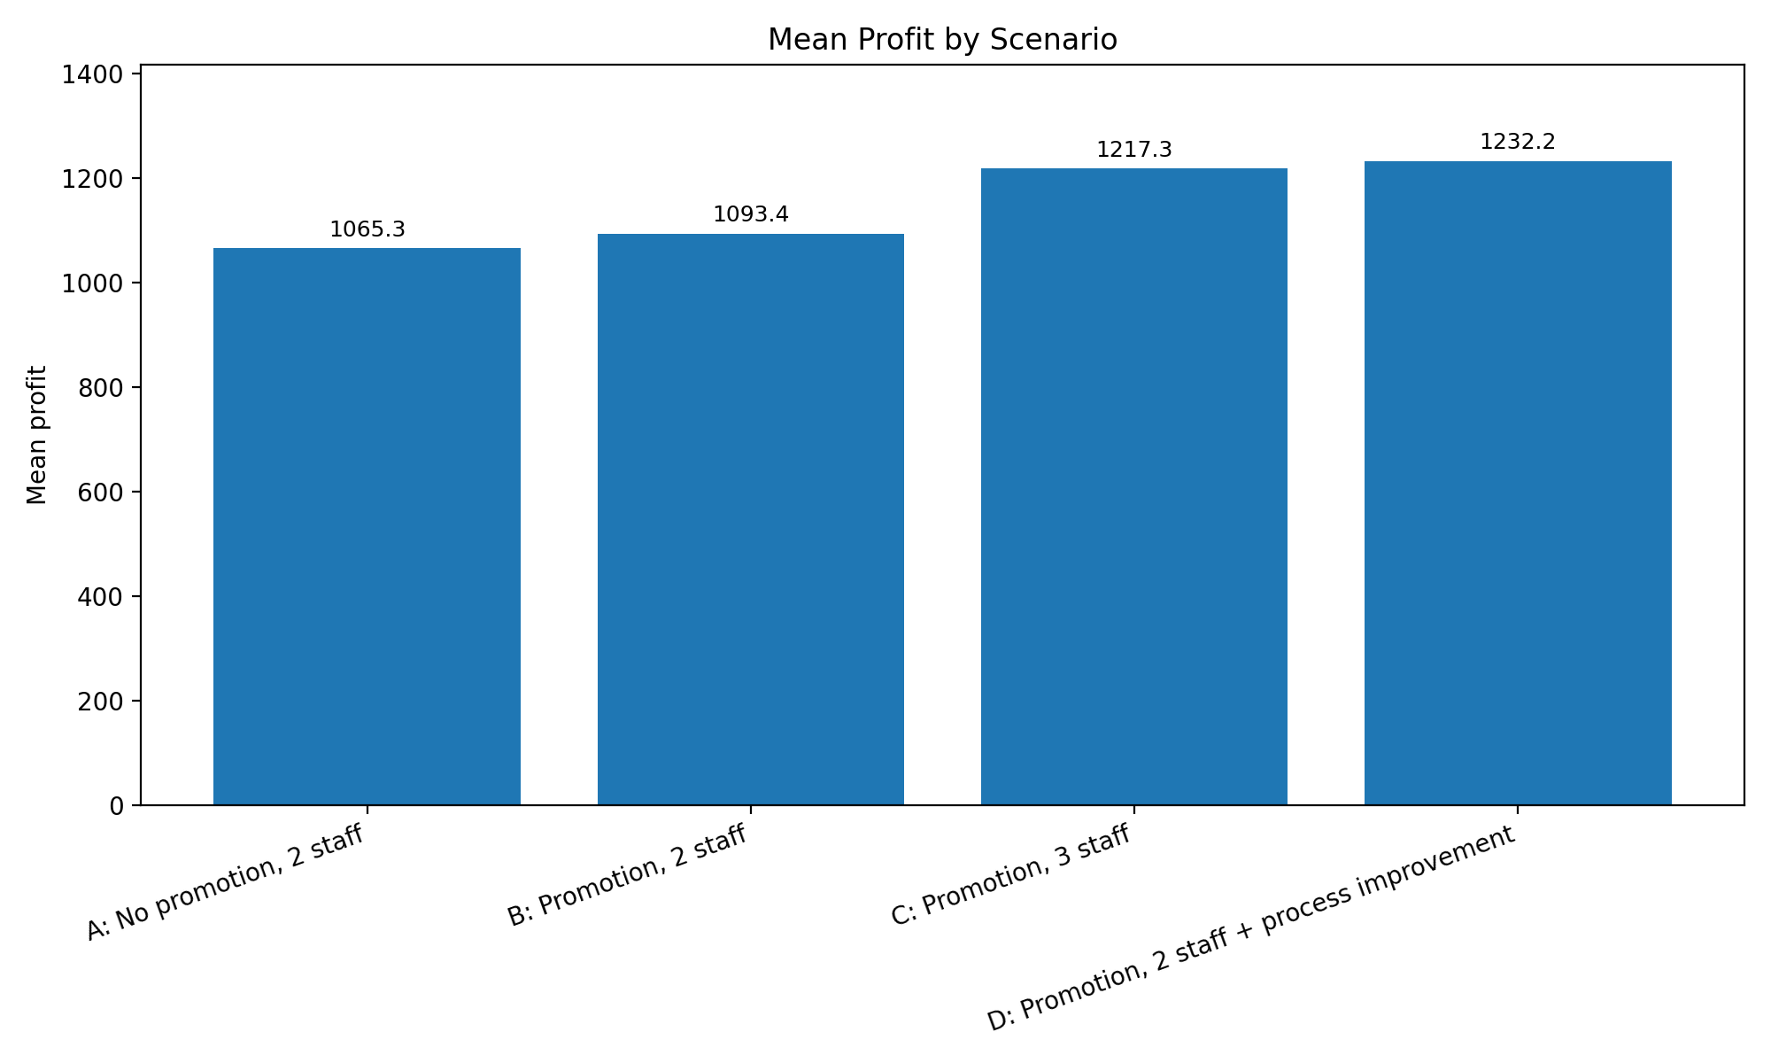
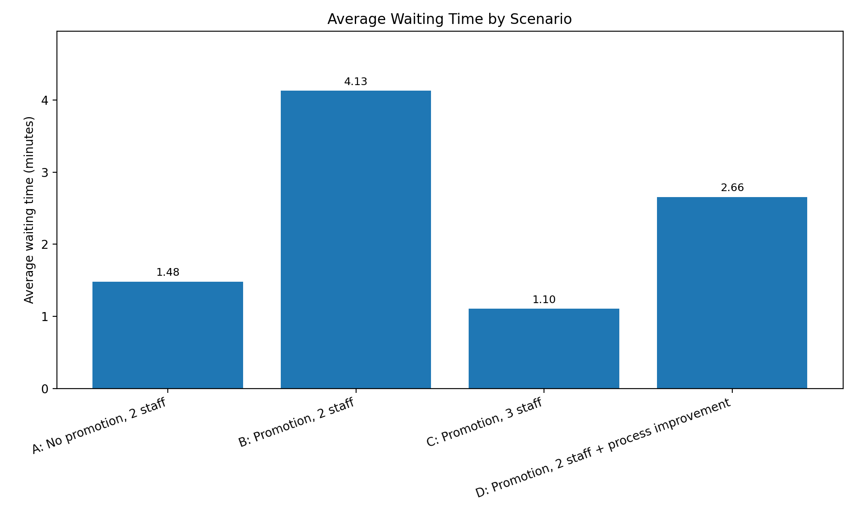
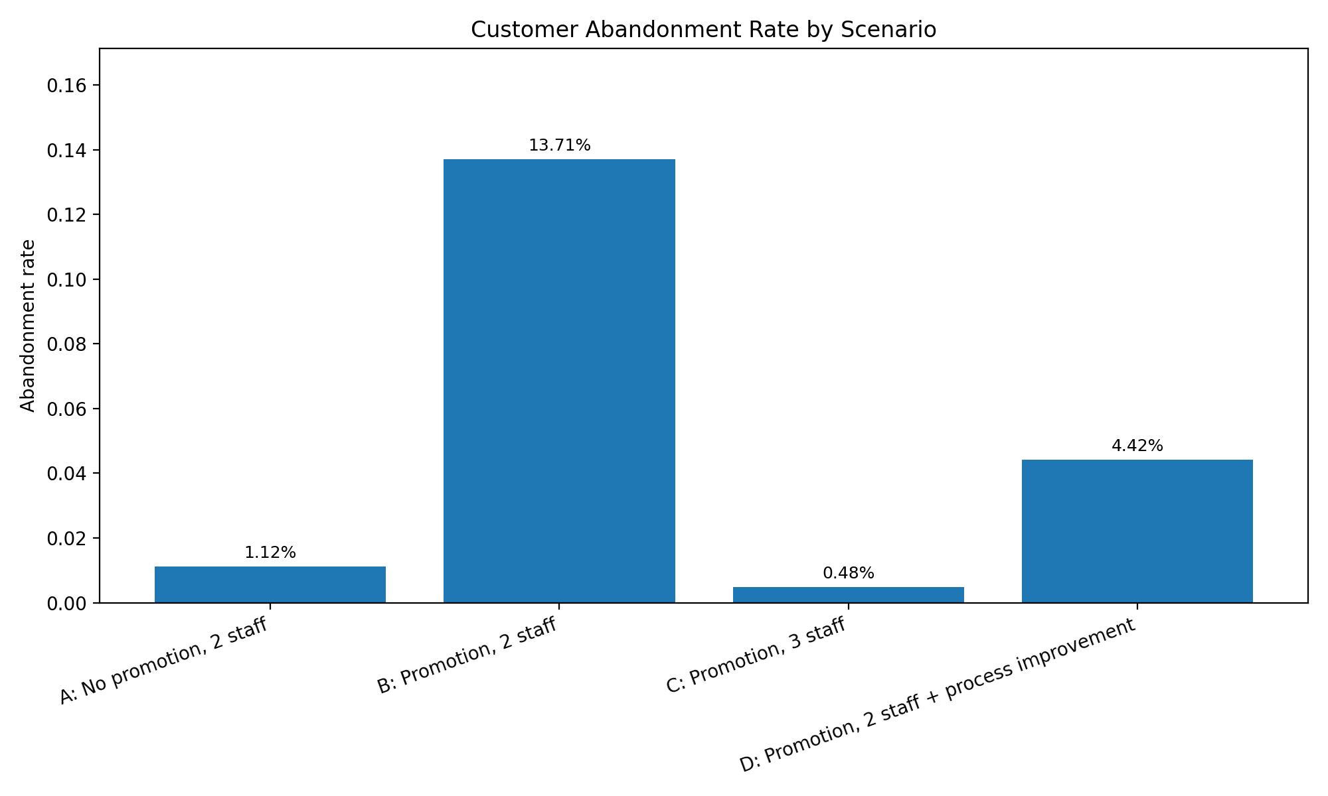
1 Simulation Results & Analysis
Promotion does increase profit
All promotion scenarios (BCD) have higher mean profit than non-promotion scenarios (A)
Without improving service capacity, queue pressure rises significantly. (B)
not all of the extra demand created by the promotion is converted into sales, because part of it is lost when the system becomes overloaded.
By improving its operating capacity, it can significantly reduce demand loss caused by queueing.
Either by adding staff or improving the process
Business Interpretation 1: Promotion itself can improve profit, but it also creates much greater queueing pressure.
Business Interpretation 2: Adding one more staff or improving the process can clearly improve service performance.

Slide 34
2 Risk & Downside Analysis
Focus on analyze VaR95 and CVaR95, using Scenario A as baseline.
Business Interpretation 3: Process improvement (D) not only raises average profit, but also reduces losses in extreme unfavorable situations. So from a risk-control perspective, Scenario D is the more robust option.
By contrast, Scenario B and Scenario C both have larger profit fluctuations than Scenario D under less favorable scenarios.
Scenario D is the most stable option / has most stable profit performance under unfavorable conditions.
Scenario B
Scenario C
Scenario D
Higher mean profit, but queue risk remains
Stable, but less efficient under weaker demand
Lowest downside risk
VaR95 Shortfall
VaR95 Shortfall
VaR95 Shortfall
74.36
59.51
0.00
CVaR95 Shortfall
CVaR95 Shortfall
CVaR95 Shortfall
108.81
112.78
47.67
Interpretation
Interpretation
Interpretation
Vulnerable when peak demand rises
Higher labor cost reduces its edge
Most stable under unfavorable cases

Slide 35
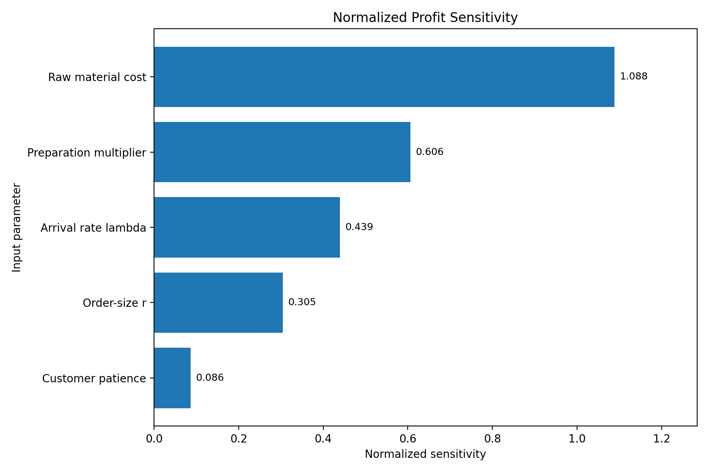
3 Sensitivity Analysis
Top drivers
1. Raw material cost
2. Preparation multiplier
3. Arrival rate
Business Interpretation 4: When a store runs a promotion, it should not only focus on whether more customers come, but also on whether supply chain support and in-store execution can keep up.
Business Interpretation 5: If the store wants to improve results without adding too much labor cost, improving preparation efficiency is more effective than simply hoping customers will be more patient.

Slide 36
07
Final Conclusions & Recommendations

Slide 37
Optimal Strategy: Process Optimization
(Scenario D)
Our simulation results strongly indicate that Scenario D is the most profitable strategy. This is achieved by enhancing operational efficiency without increasing staff.
Average Profit (KPIs)
1258.98 HIGHEST PERFORMANCE
Customer Churn Rate
2.62%(↓ from 9.93% in Scenario B)
Average Waiting Time
2.12 min(↓ from 3.57 min in Scenario B)
Downside Risk (VaR95 / CVaR95)
0.65 / 49.12 LOWEST RISK PROFILE

Slide 38

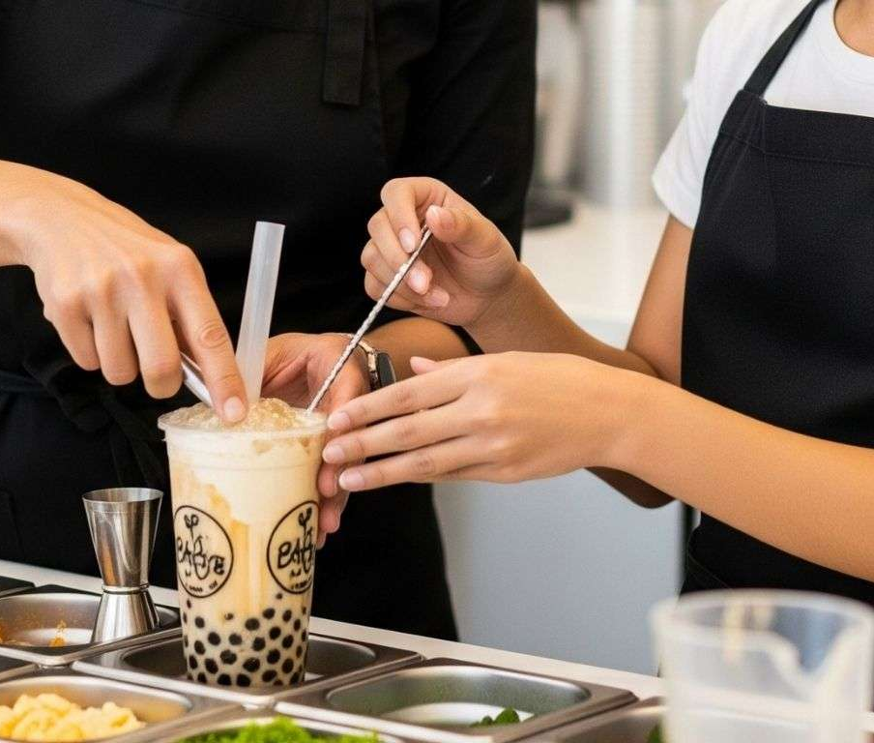
Managerial Implication:
Prioritize Process Optimization
The primary recommendation is to prioritize process optimization over immediate staffing increases during a promotion. This can be implemented through several practical measures:
Standardize Menu
Focus on popular and easy-to-make items to reduce variability.
Batch Similar Orders
Process multiple identical orders together to save time.
Pre-prepare Key Components
Prepare bases or toppings for popular drinks in advance.
Limit Complex Customizations
Reduce the number of special requests to streamline operations.
These steps directly address the root cause of bottlenecks and are more cost-effective than hiring additional staff.
Notes:
So, what does this mean for the manager? The key takeaway is to focus on making the process more efficient first, before thinking about hiring more people. This can be done by simplifying the menu for the promotion, making similar drinks in batches, prepping popular items ahead of time, and limiting complicated custom orders. These steps tackle the problem at its source and are a smarter investment than just adding more hands.

Slide 39

Contingency Strategy: Staff Augmentation (Scenario C)
While Scenario D offers the highest profit, its success relies on the ability to genuinely reduce process times. If the store's operations are already highly optimized, Scenario C becomes a safer, more reliable alternative to maintain service standards.
What is Scenario C?
Strategically hiring one temporary worker for a 3-hour shift specifically during peak hours to supplement the existing team.
Lowest Waiting Time
Ensures customers are served promptly, cutting down perceived wait times.
Lowest Churn Rate
Significantly minimizes lost sales from frustrated customers leaving before ordering.
Stable Service Quality
Maintains a predictable, high-quality experience even with the promotion's increased peak volume.
Notes:
Now, what if process optimization isn't possible? That's where our contingency plan, Scenario C, comes in. This involves hiring one temporary worker for just three hours during the busiest time.
While it's not the most profitable option, it guarantees the shortest waiting times and the least number of customers leaving frustrated. This is especially important when the whole-day promotion makes an already busy peak hour even more chaotic.

Slide 40
Managerial Implication: Choose Based on Operational Flexibility
The choice between Scenario D and C hinges on a realistic assessment of the store's operational flexibility.
Scenario D (Profit-Optimal)
Scenario C (Service-Stable)
Choose this if the store has tangible and effective process improvements that can be executed. This is the best choice for maximizing profit.
Choose this if process optimization is not feasible or if the actual customer flow is expected to be much higher than normal. This is the best choice for maintaining service quality and customer satisfaction.
Management must carefully evaluate their ability to implement process changes before making a decision.
Notes:
The decision between these two strategies boils down to one question: can we actually make our processes more efficient? If yes, go with Scenario D for higher profits. If not, or if you expect way more customers than usual, Scenario C is the safer bet to keep your service smooth and customers happy. It's a strategic decision based on the store's real capabilities.

Slide 41

Sensitivity Analysis: how do top drivers affect the profit?
Arrival Rate (Lambda)| Profit variation: ~ ￥253.77
Raw Material Cost| Profit variation: ~ ￥ 248.87
Preparation Speed (Efficiency)| Profit variation: ~ ￥ 170.14
Notes:
To understand the risks involved, we conducted a sensitivity analysis. This showed us which factors have the biggest impact on profit. The top three are: the number of customers showing up, the cost of raw materials, and how fast the drinks are made. Changes in these areas cause the biggest swings in profit. Factors like how much each customer spends or how long they're willing to wait are far less critical.

Slide 42
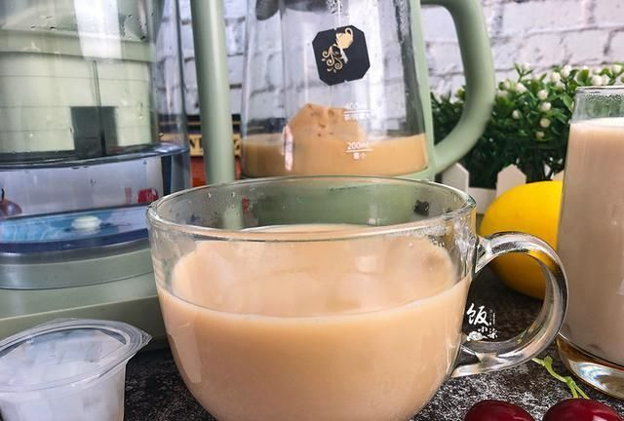
Managerial Implication: Focus on What Matters Most
This analysis underscores that the main risks and opportunities lie in three key areas. Therefore, the shop should prioritize monitoring and managing these elements:
Exactly How Many Customers The Promotion Can
Whether The Cost Of The Raw Material Rises
Operational Efficiency
By focusing on these three pillars, the shop can effectively manage its profit and navigate the challenges of a promotional event.
Notes:
So, what should managers focus on? Our analysis clearly shows that the biggest levers for profit are managing how many customers come, controlling ingredient costs, and making drinks faster. These are the three areas that require the most attention and effort during a promotion. Getting these right will go a long way in ensuring success.

Slide 43
Recommended Strategic Framework
Based on our simulation, this is our final recommendation:
Primary Strategy (Scenario D)
Contingency Strategy (Scenario C)
ACTION
Maintain 2 employees but implement strict process optimizations.
CONTINGENCY ACTION
If process optimization is not feasible or customer flow is much higher than expected, hire one temporary worker for a 3-hour shift.
This serves as a safety net to avoid long queues and maintain service quality.
KEY MEASURES
●Limit promotion to select drinks
●Create a standardized promotional menu
●Minimize complex customizations
●Pre-prepare key components for best-sellers
●Create a dedicated, expedited process for the most popular item
Notes:
Putting it all together, here is our recommended strategic framework. The primary plan is Scenario D: keep your regular two employees but make sure your processes are as efficient as possible. This means simplifying the menu, prepping ahead, and maybe even creating a special fast lane for your most popular drink. If that's not possible, or if you're swamped with customers, switch to the contingency plan, Scenario C, and bring in a temporary worker for three hours.

Slide 44
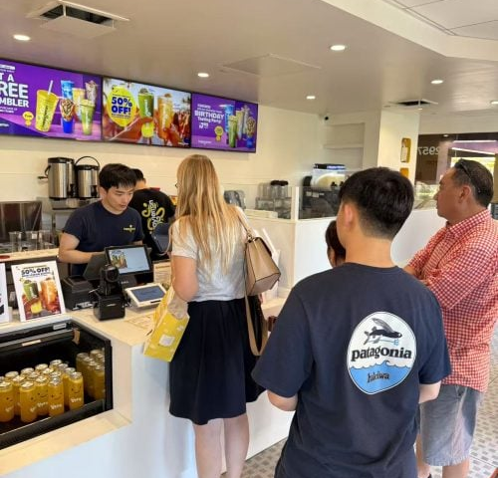
Discouraged Strategy: Scenario B
Scenario B: Implementing the promotion without any additional staff or process improvements is NOT RECOMMENDED.
While this approach may increase average profit on paper, it introduces major operational problems that undermine long-term success:
Significant Congestion
Long wait times, overcrowding, and a chaotic store environment.
High Customer Churn
Impatient customers will abandon their purchase and leave empty-handed.
Long-Term Reputational Damage
A poor experience harms brand loyalty and future business.
Notes:
There's one strategy we strongly advise against: Scenario B. This is where you run the promotion without adding staff or improving your process. Yes, you might see a higher average profit on paper, but the reality is long lines, frustrated customers leaving, and a messy store. This kind of experience can hurt your brand's reputation in the long term, so it's a gamble not worth taking.

Slide 45

08
Model Limitations
UNDERSTANDING THE CONSTRAINTS OF SIMULATION
Notes:
Now, let's move to the second part of our presentation, where we discuss the limitations of our simulation model. It's important to understand these constraints to properly interpret our findings.

Slide 46
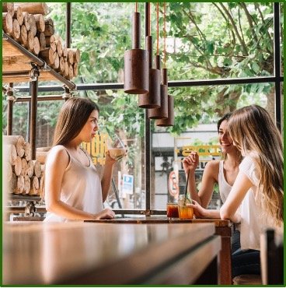
Acknowledging the Model's Constraints
1. Data Source Limitation
The model uses assumed parameters for pricing, costs, and service times instead of real-world store data. Integrating actual operational data would significantly improve accuracy.
2. Simplified Customer Patience
Patience is approximated with a triangular distribution. In reality, it is a complex function of queue length, weather, time of day, and overall brand perception.
3. Lack of Role Specialization
The model assumes employees handle orders end-to-end, and does not account for common real-world role specialization (e.g., dedicated cashiers, baristas).
Notes:
First, our model uses assumed data for prices and times, not real data from a shop. Second, we simplified the concept of customer patience, which in reality is affected by many things like the weather or how the brand is perceived. Third, our model assumes each employee does everything for an order, which isn't how most real shops work, where people have specialized roles like cashier or drink maker.

Slide 47
Further Limitations and Conclusion
04 Process Optimization Validation
The effectiveness of the process optimization measures assumed in Scenario D is a theoretical input and needs to be validated through real-world trials.
Conclusion on Limitations
This model should be primarily used as a tool to compare the relative performance of different operational strategies rather than a predictor of the absolute profit for any specific bubble tea shop. The insights are most valuable for strategic decision-making.
05 Cost and Price Variability
The model uses a random cost rate within product categories. A more precise model could be built with actual menu data for fixed prices and costs per drink.
Notes:
Fourth, the benefits of process optimization in Scenario D are based on theory and need to be tested in real life. Fifth, our cost model is simplified; a real menu with fixed prices and costs for each drink would make it more accurate. To sum up, our model is best used to compare different strategies against each other, not to predict exactly how much money a specific shop will make. The real value is in the strategic insights it provides.

Slide 48
Q & A
THANK YOU
Notes:
That concludes our presentation. Thank you for your attention. We are now ready to take any questions you may have.

